Slide 1
UNVEILING MARKET INSIGHTS

Slide 2
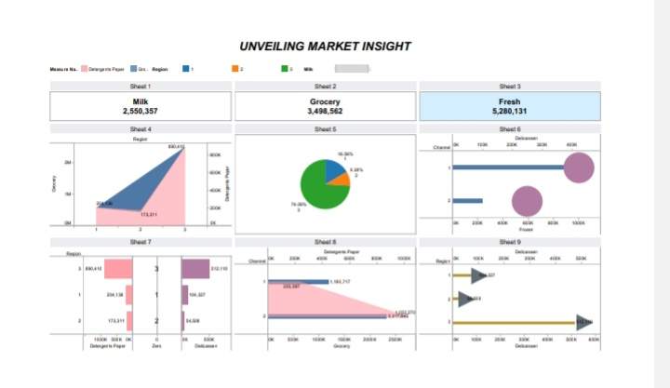
DASHBOARD The dashboard is a page which contain multiple indicator on it and displayed at a time

Slide 3
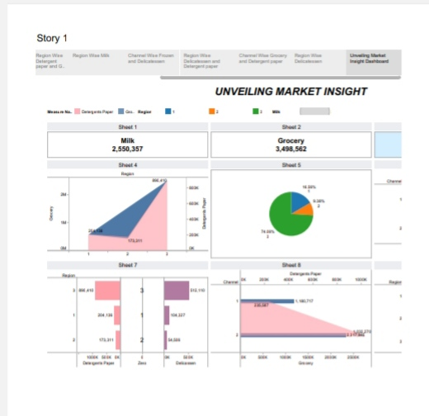
STORY Storyboard will show the flow ,interactions and structures of a project almost like a map showing a how to get from a starting point to a distination

Slide 4
THANKYOU

